Slide 1












PLAYER 1
HIGHSCORE 2500
PLAYER 2
ROBBER
Add a short description

Slide 2











01
07
12
AGENDA
TOPICS COVERED
Character
in game
demo

Slide 3













CHARACTER

Slide 4



01
07
12
PLAYER
WE PLAY THE ROLE OF A THIEF WHO WILL STEAL DIAMONDS FROM AMONG THE GUARDS

Slide 5

01
07
12
GUARD
as guards, they have to patrol to guard the diamonds. This guard is an NPC who will arrest the player if detected

Slide 6
IN GAME

Slide 7


HIGHSCORE 2500
PLAYER 2
FITUR PLAYER
The player will stop or disable if a guard is detected
The player's need to avoid guard
The player's main goal is to take diamonds

Slide 8
CODE

Slide 9
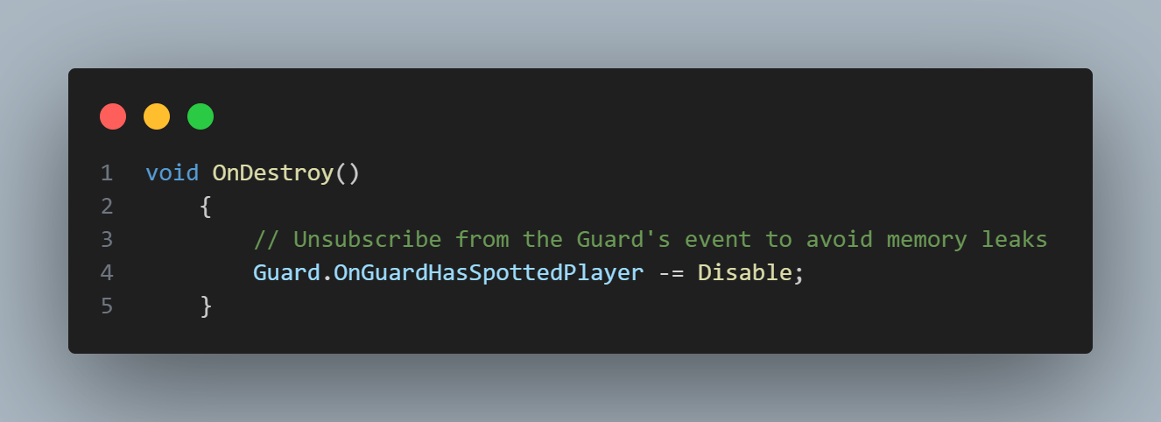
PLAYER DISABLE
01
07
12

Slide 10
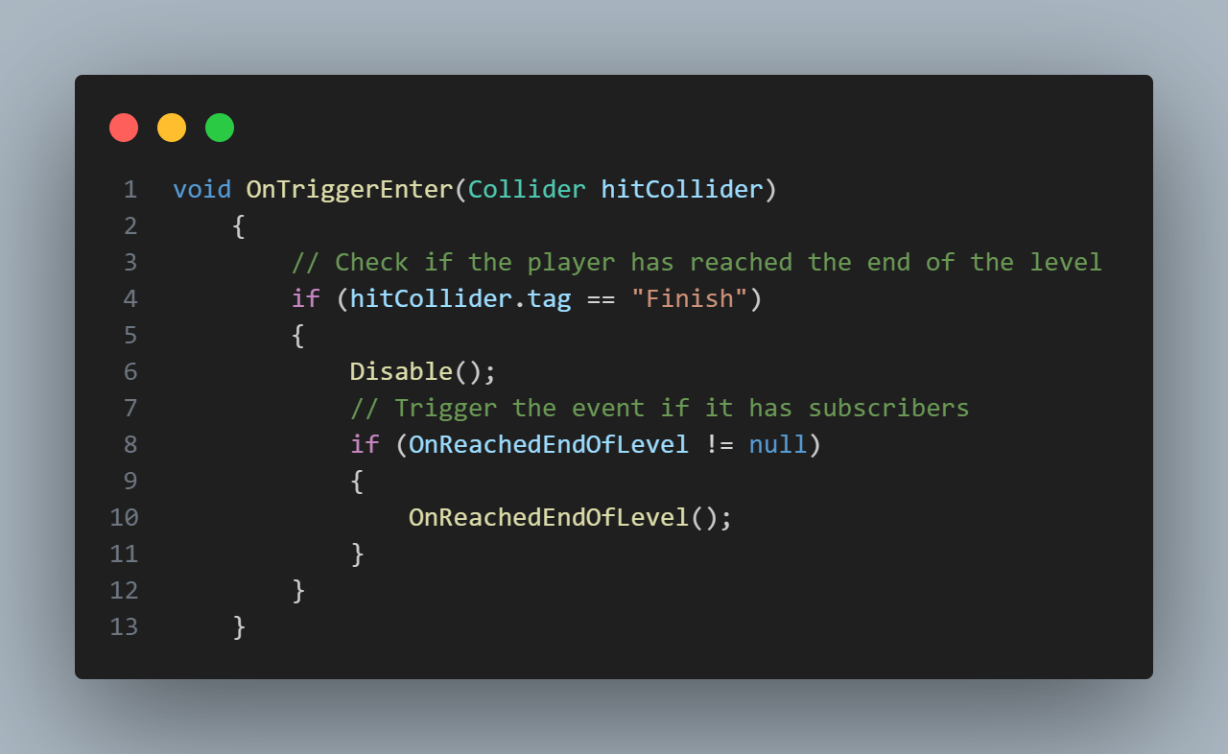
PLAYER FINISH
01
07
12

Slide 11
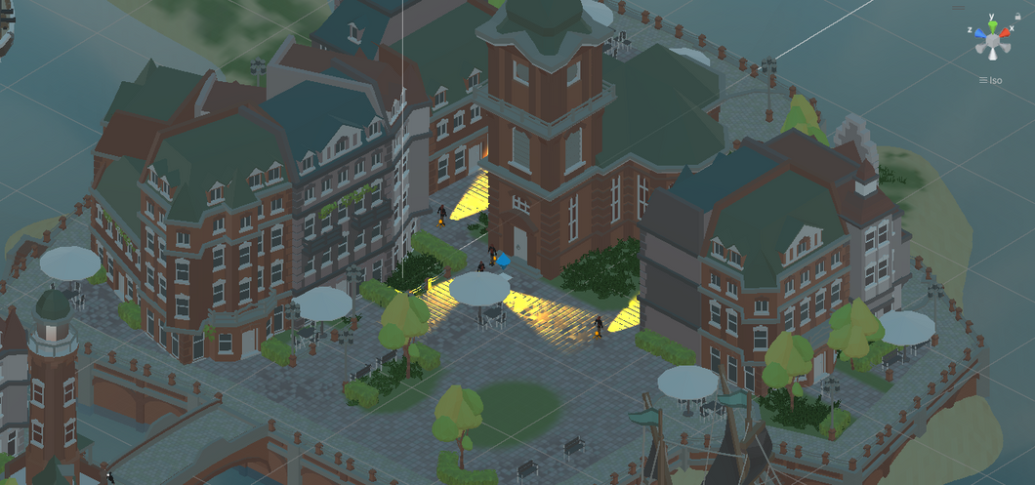
HIGHSCORE 2500
PLAYER 2
FITUR GUARD
The guard will patrol according to the specified path
guard will only detect the player if the player enters the range
The guard will change the color of the light if it detects a player

Slide 12
CODE

Slide 13
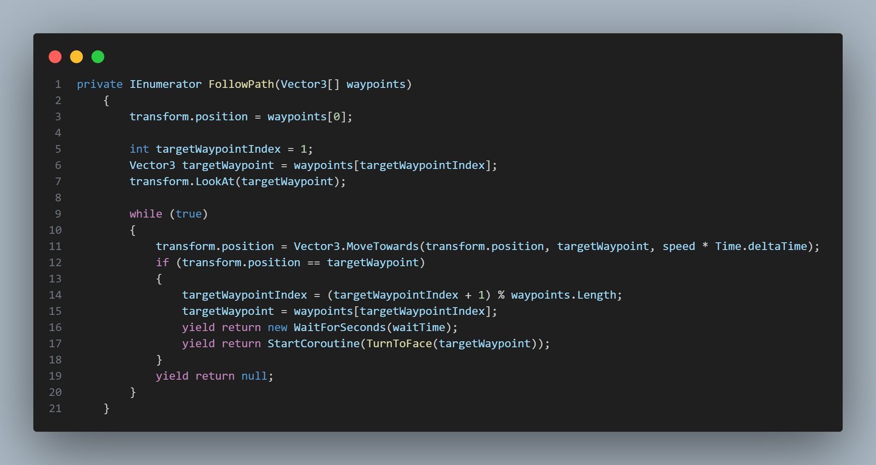
GUARD
PATROL
01
07
12

Slide 14
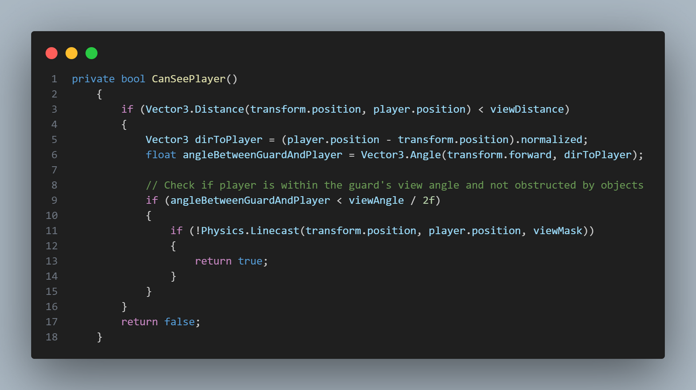
GUARD
DETEC
01
07
12

Slide 15
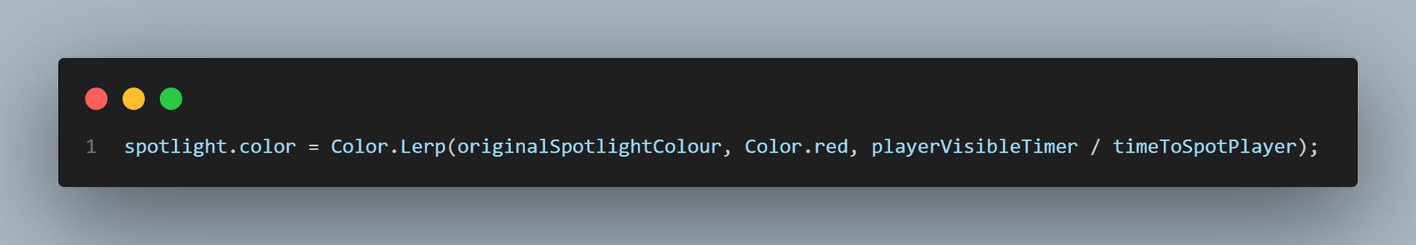
GUARD
CHANGE COLOR
01
07
12

Slide 16
DEMO

Slide 17






THANK YOU!
INSERT A PARTING OR
call-to-action message here.

